Slide 1
Inside Open LLM
Kubernetes Deployment
Olga Mirensky - Platform Engineer - ANZx
May 2024

Slide 2





Agenda
1. Model
2. Inference and serving
3. k8s Deployment Requirements
4. Cluster Hardware
5. Demo
6. What’s next and Q&A
requests:
cpu: 8 memory: 29Gi ephemeral: 80Gi nvidia.com/gpu: 1

Slide 3
LLM

Slide 4

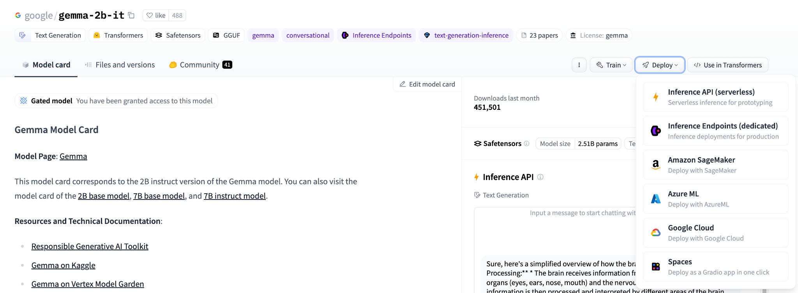
Meet The Star
Notes:
2 B / 7 B
Instruct
Deploy options
Announced late Feb 2024 Very Light-weight, easy to experiment with, OSS. GPT4 - 175B, Gemini - 0.5 trillion - TODO confirm
Not only/important number to compare models on
Accept License
—-
Theory
Base Models: The base version of a model like Gemma is typically trained on a broad dataset to perform a wide range of tasks without specific tuning towards following instructions. Its training is focused on general language understanding and generation.
Instruct Models: Instruct versions are fine-tuned or additionally trained to prioritize and understand user instructions better. This training involves using datasets where the model outputs are aligned more closely with detailed user prompts or instructions, often involving human feedback or specialized datasets that emphasize task fulfillment based on instructions.

Slide 5
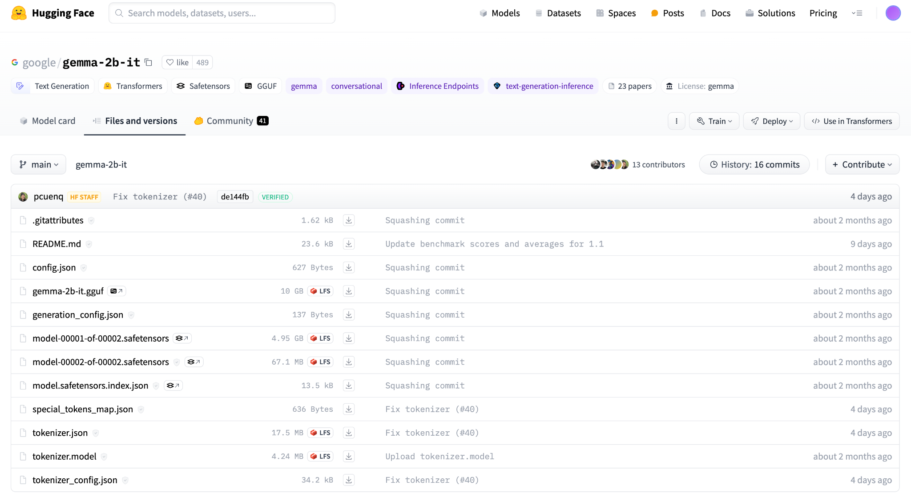
What’s inside?

Slide 6
We’ve got the model, now what?
Inference and serving
And a million other platform-y things
Gateway
Load Balancing
HA
Resiliency
Cost efficiency
Resource management
Caching
Components upgrade
Model updates
Monitoring
Logging
Security & compliance
Performance optimization
Notes:
Inference = processes involved in running pre-trained machine learning
LB, scaling, HA, resource management cost-efficiency
https://cloud.google.com/blog/products/containers-kubernetes/serving-gemma-on-google-kubernetes-engine-deep-dive
https://cloud.google.com/kubernetes-engine/docs/tutorials/serve-gemma-gpu-vllm
vLLM is fast with:
State-of-the-art serving throughput
Efficient management of attention key and value memory with PagedAttention
Continuous batching of incoming requests
Fast model execution with CUDA/HIP graph
Quantization: GPTQ, AWQ, SqueezeLLM, FP8 KV Cache
Optimized CUDA kernels

Slide 7
Minimal k8s Deployment

Slide 8
Kubernetes Deployment
apiVersion: apps/v1
kind: Deployment
metadata:
name: vllm-gemma-deployment
spec:
replicas: 1
selector:
matchLabels:
app: gemma-server
template:
metadata:
labels:
app: gemma-server
ai.gke.io/model: gemma-2b-it
ai.gke.io/inference-server: vllm
examples.ai.gke.io/source: user-guide
spec:
containers:
- name: inference-server
image: us-docker.pkg.dev/vertex-ai/vertex-vision-model-garden-dockers/pytorch-vllm-serve:20240220_0936_RC01
resources:
requests:
cpu: "2"
// demo deploy,
// bare minimum
// more advanced
// options, comments
Notes:
This deployment comes from Vertex AI -> Deploy -> GKE

Slide 9
Kubernetes Deployment
ai.gke.io/model: gemma-2b-it
ai.gke.io/inference-server: vllm
examples.ai.gke.io/source: user-guide
spec:
containers:
- name: inference-server
image: us-docker.pkg.dev/vertex-ai/vertex-vision-model-garden-dockers/pytorch-vllm-serve:20240220_0936_RC01
resources:
requests:
cpu: "2"
memory: "7Gi"
ephemeral-storage: "10Gi"
nvidia.com/gpu: 1
limits:
cpu: "2"
memory: "7Gi"
ephemeral-storage: "10Gi"
nvidia.com/gpu: 1
command: ["python3", "-m", "vllm.entrypoints.api_server"]
args:
- --model=$(MODEL_ID)
- --tensor-parallel-size=1
- --dtype=half
env:

Slide 10
Kubernetes Deployment
ephemeral-storage: "10Gi"
nvidia.com/gpu: 1
command: ["python3", "-m", "vllm.entrypoints.api_server"]
args:
- --model=$(MODEL_ID)
- --tensor-parallel-size=1
- --dtype=half
env:
- name: MODEL_ID
value: google/gemma-2b-it
- name: HUGGING_FACE_HUB_TOKEN
valueFrom:
secretKeyRef:
name: hf-secret
key: hf_api_token
volumeMounts:
- mountPath: /dev/shm
name: dshm
volumes:
- name: dshm
emptyDir:
medium: Memory
nodeSelector:
initContainers: - command: [ aws s3 cp s3://mdl/ …]
initContainers: - command: [ gsutil cp gs://mdl/ …]
Cloud storage, OCI-compatible registry => better integration, IAM, etc

Slide 11
Kubernetes Deployment
- name: MODEL_ID
value: google/gemma-2b-it
- name: HUGGING_FACE_HUB_TOKEN
valueFrom:
secretKeyRef:
name: hf-secret
key: hf_api_token
volumeMounts:
- mountPath: /dev/shm
name: dshm
volumes:
- name: dshm
emptyDir:
medium: Memory
nodeSelector:
cloud.google.com/gke-accelerator: nvidia-tesla-t4
PVC
spec:
accessModes:
- ReadWriteMany
resources:
requests:
storage: 100Gi

Slide 12
Kubernetes Cluster
gcloud container node-pools create gpupool \
. . .
--accelerator "type=nvidia-tesla-t4,gpu-driver-version=latest,count=1" \
--machine-type "n1-standard-8" \
apiVersion: eksctl.io/v1alpha5
kind: ClusterConfig
. . .
nodeGroups:
- name: gpu-nodegroup
instanceType: p3.2xlarge
Attachable GPU
GCP: General purpose - n1, (GPU T4, P4, V100)
Integrated GPU
GCP: Accelerator-optimized. a2, a3, g2 (GPU: L4, A100, H100) AWS: P- and G- Series
Notes:
These are not the recommended settings but we don’t have L4 in AU
AWS: G4dn instances, powered by NVIDIA T4 GPUs, are the lowest cost GPU-based instances in the cloud for machine learning inference and small scale training. They also provide high performance and are a cost-effective solution for graphics applications that are optimized for NVIDIA GPUs using NVIDIA libraries such as CUDA, CuDNN, and NVENC. Source: https://aws.amazon.com/ec2/instance-types/g4/
https://cloud.google.com/compute/docs/gpus/about-gpus#gpu-machine-types
https://cloud.google.com/compute/docs/gpus
gcloud compute accelerator-types list
https://cloud.google.com/compute/vm-instance-pricing#accelerator-optimized
8 GPUs, 208 CPUs

Slide 13
Demo

Slide 14
Demo - Interacting with the Model
+ USER_PROMPT='Share some mind-blowing statistic related to running an OSS LLM on a kubernetes cluster'
+ curl -X POST http://localhost:8000/generate -H 'Content-Type: application/json' -d @-
{"predictions":["Prompt:\n<start_of_turn>user\nShare some mind-blowing statistic related to running an OSS LLM on a kubernetes cluster<end_of_turn>\nOutput:\n**The numbers don't lie:**\n\n* **12.6 petabytes of data** was processed and trained by the LLM.\n* **5.7 trillion parameters** were learned by the LLM.\n* **384,000 training steps** were run to build the model.\n* **1,000+ cores** were used to train the LLM.\n* **60+ different languages** were supported by the LLM.\n* **40% of the world's knowledge** could fit on the LLM's hard drive."]}%

Slide 15
KServe

Slide 16

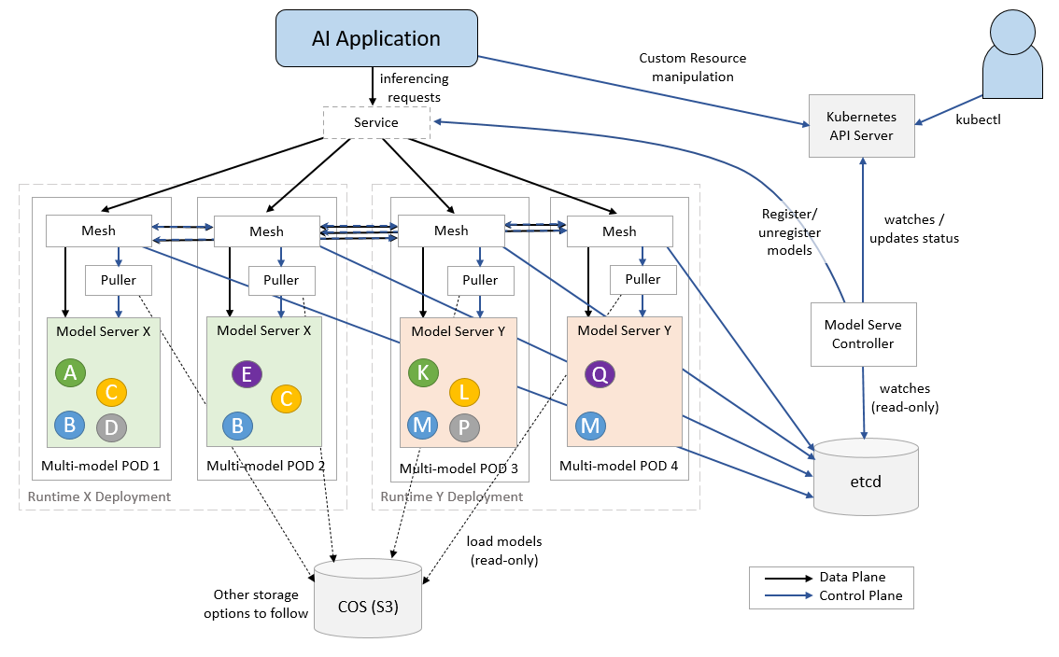
KServe - Model Mesh
https://kserve.github.io/website/latest/modelserving/mms/modelmesh/overview/

Slide 17
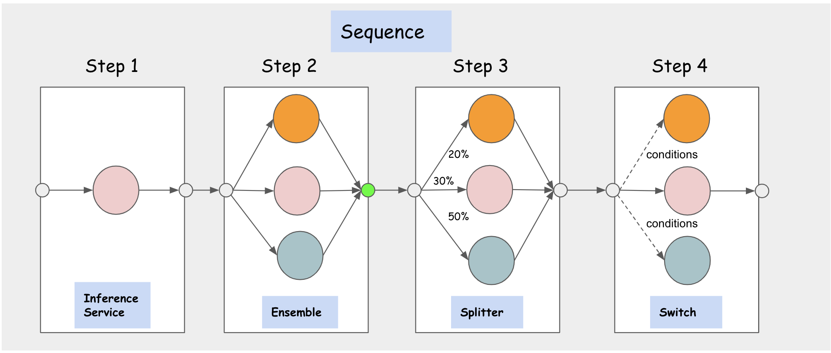
KServe
https://kserve.github.io/website/latest/modelserving/inference_graph

Slide 18

Do I need a Mortgage to Experiment Using AI?
Disclaimer: This is not endorsement/recommendation.
Quotas
Billing budgets alerts
Spot provisioning
Estimate with GenAI chat and walk through official docs
👩‍💻
Can you provide estimated Compute Engine costs for 1 hour running following GKE nodepool
```
container node-pools create gpupool-t4 \
--accelerator type=nvidia-tesla-t4,count=1 \
--machine-type=n2-standard-32 \
--num-nodes=1 --spot
```
. . .
Total Estimated Cost per Hour: $0.4387 (VM) + $0.105 (GPU) = $0.5437 per hour
After SPOT discount
Notes:
Quotas - 0 initially, increase autoapproved
Billing alerts - not real time.
TODO - n2-standard-32 is wrong type. Get correct example.
—-
Understand requirements
Understand resource usage and costs
Understand compatibility and availability
Accelerator-optimized VMs available in limited regions
Accelerator + Machine type compatibility
Check Quotas
GPU_ALL_REGIONS

Slide 19
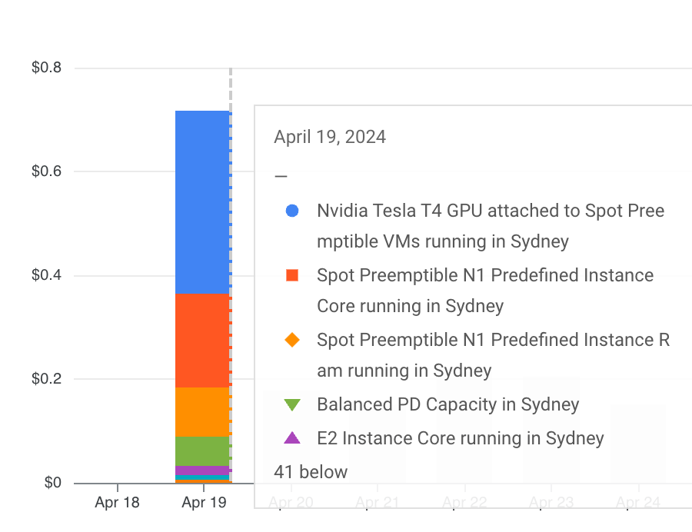
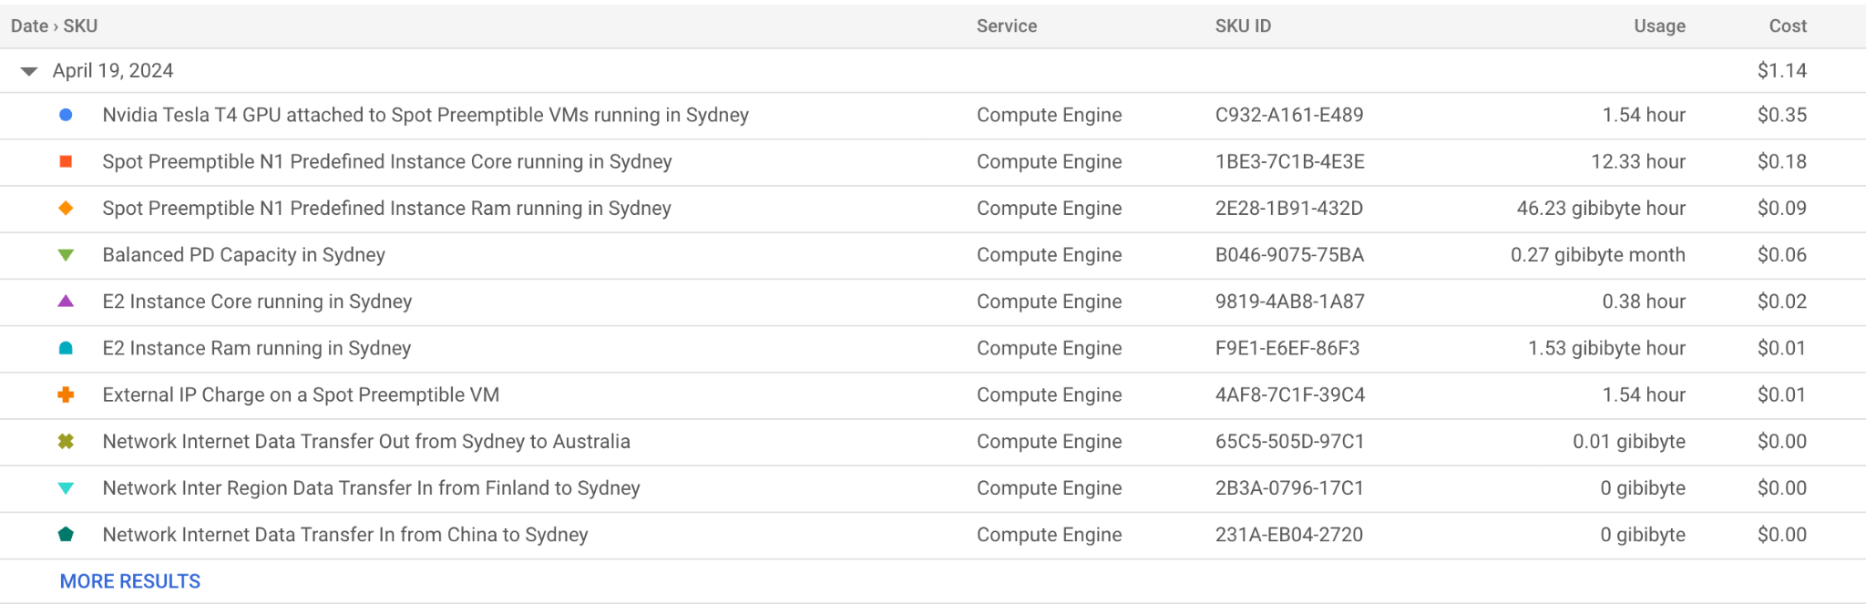
Actual Cost - 90 min 2B model
GKE cluster with 1 `n1-standard-8` node + Nvidia T4 GPU, spot.
GPU
VM

Slide 20
What’s next
Advanced Serving
And Deployment KServe
Skypilot
Newsletter
TLDR +
Cloud ML/AI Hub
https://aws.amazon.com/machine-learning/learn
Run locally + RAG
https://github.com/binchenX/rag-up
Q & A
Explore 🤗
Browse models*
Read blogs
Explore
(*model access is gated)
Notes:
https://cloud.google.com/blog/products/containers-kubernetes/serving-gemma-on-google-kubernetes-engine-deep-dive
AWS AI/ML learn: https://aws.amazon.com/machine-learning/learn/
The Transformer plays a role in preparing the input data before it reaches the predictor and, optionally, processing the output data from the predictor before it is returned to the client. This can include tasks like normalization, encoding categorical variables, handling missing values, and more.

